Slide 1

Welcome To
Team 4
Done By:
Dominic S10222894G
Yang Jun S10203987G
Shanthal - S10222337A
You Sheng S10224441J
Notes:
Shanthal-
Welcome

Slide 2
Overview
1) Focus of the
assignment
3) Opportunity Statement
5) Design
6) Q and A
2) Research: primary/secondary
4) Ideas

Slide 3
OUR FOCUS FOR THE ASSIGNMENT!!!

Slide 4

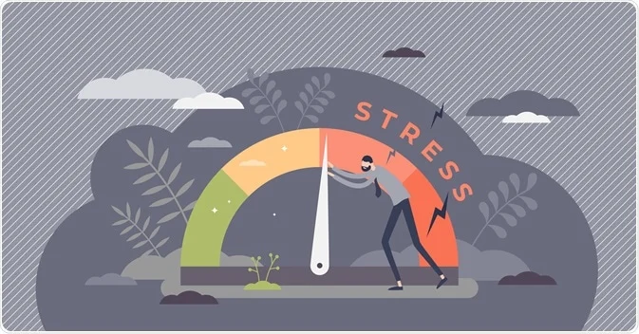
Group Topic: Education
Area of focus: Stress level of students
Notes:
Focus on stress whether they were too stressed

Slide 5
RESEARCH DETAILS

Slide 6

Who did we interview
Regent Secondary School
CJC
Ngee Ann Poly
NUS
Y1 Early Childhood Student
Y1 Student studying Chemistry
A J1 student at CJC
Secondary 4 student
01
02
03
04
Purpose
For us to have an idea on what types of stress students face in their daily life.

Slide 7
What we discovered (primary research)
01 | Students found it difficult to collaborate with their peers in group projects
02 | Students found studying for Exams / Assignments extremely tough
03 | Challenging to focus in online class
04 | Hard to form close friendships
05 | Serious lack of time due to poor time management
06 | Challenging to manage stress
Notes:
Firstly we found out that Students found it difficult to collaborate with their team
We found out that students have a poor management - due to the points from 1 to 4 - 5 & 6

Slide 8

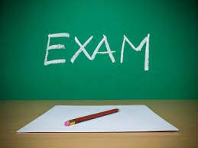
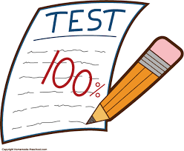

Singapore students.. (secondary research)
01
02
86% of the students feel distressed as they want to do well in school
3rd globally in amount of time spent studying at 9.4 hours/week.
03
04
3% Students in Singapore are made fun of at least a few times a month.
76% of Singaporean students feel anxious to take a test, even if they are well prepared for it.

Slide 9
How might we relieve stress for students to help them deal better with their stress factors so that they can perform better?
Opportunity Statement:
1.
Stress affects everyone only varying in the amount of stress.
Essential to manage stress well. If done properly stress can be used to enhance our performance. If managed poorly, it can be detrimental to us.
2.
Reasons
Many ways to manage our stress. More ways to explore how to help students manage stress.
3.
Our team consists of students and have all experienced stress from school. Better insights since we have first-hand experience.
4.
Notes:
Mention that the unlined is opp. statement .

Slide 10
OUR DIFFERENT IDEAS

Slide 11

Idea 1
A reward based app
Rationale:
Having a reward system will make doing the process for users a lot more enjoyable and they will be more likely to repeat the process/task.
This will incentivize the user to complete the task more willingly, with less friction as well as make it more satisfying.
The idea is to give rewards to the user after they accomplish a specific task that is productive

Slide 12
Idea 2
Portable Punching Bag
Rationale:
We feel that students do not exercise regularly enough and using exercise as a form to relieve their stress is a great way. This is even harder to do so because of the pandemic.
A portable punching bag allows students to exercise anywhere. Which allows students to slowly cultivate the habit of exercising.
The portable punching bag is inflatable, making it portable, comes in varying sizes and most importantly is made from a very tough material.

Slide 13
OUR CHOSEN
Idea &
Design

Slide 14
Idea 3
App Name: Mustard Seed
Rationale:
App relating to stress relief and productivity
Our team believes that 3 extremely useful ways to relieve stress is:
Gain knowledge
Be productive
Share your stress
By gaining knowledge through books relating to self-improvement, students learn how to better manage stress and manage time. They also learn how to live life to the fullest which also reduces stress.
By being productive, by doing activities that relate stress or activities that are stressing you, you are directly dealing with the stressor.
By sharing your stress and worries with others, will let a load off your chest and can gain valuable insight on the different paradigms you can see stress in.
Notes:
We cannot control the stress factors in a student’s life
Have to focus on influencing the systems and mindset of the student
We also have to aid students in relieving their stress

Slide 15

Overview of the app
The app offers 3 forms of service to assist the users.
1. It has a discussion forum for users to share their thoughts and discuss various topics.
2. It has several different functionalities to help users become more productive and relief
stress.
3. It has summaries of books to help users gain knowledge on self - improvement.

Slide 16
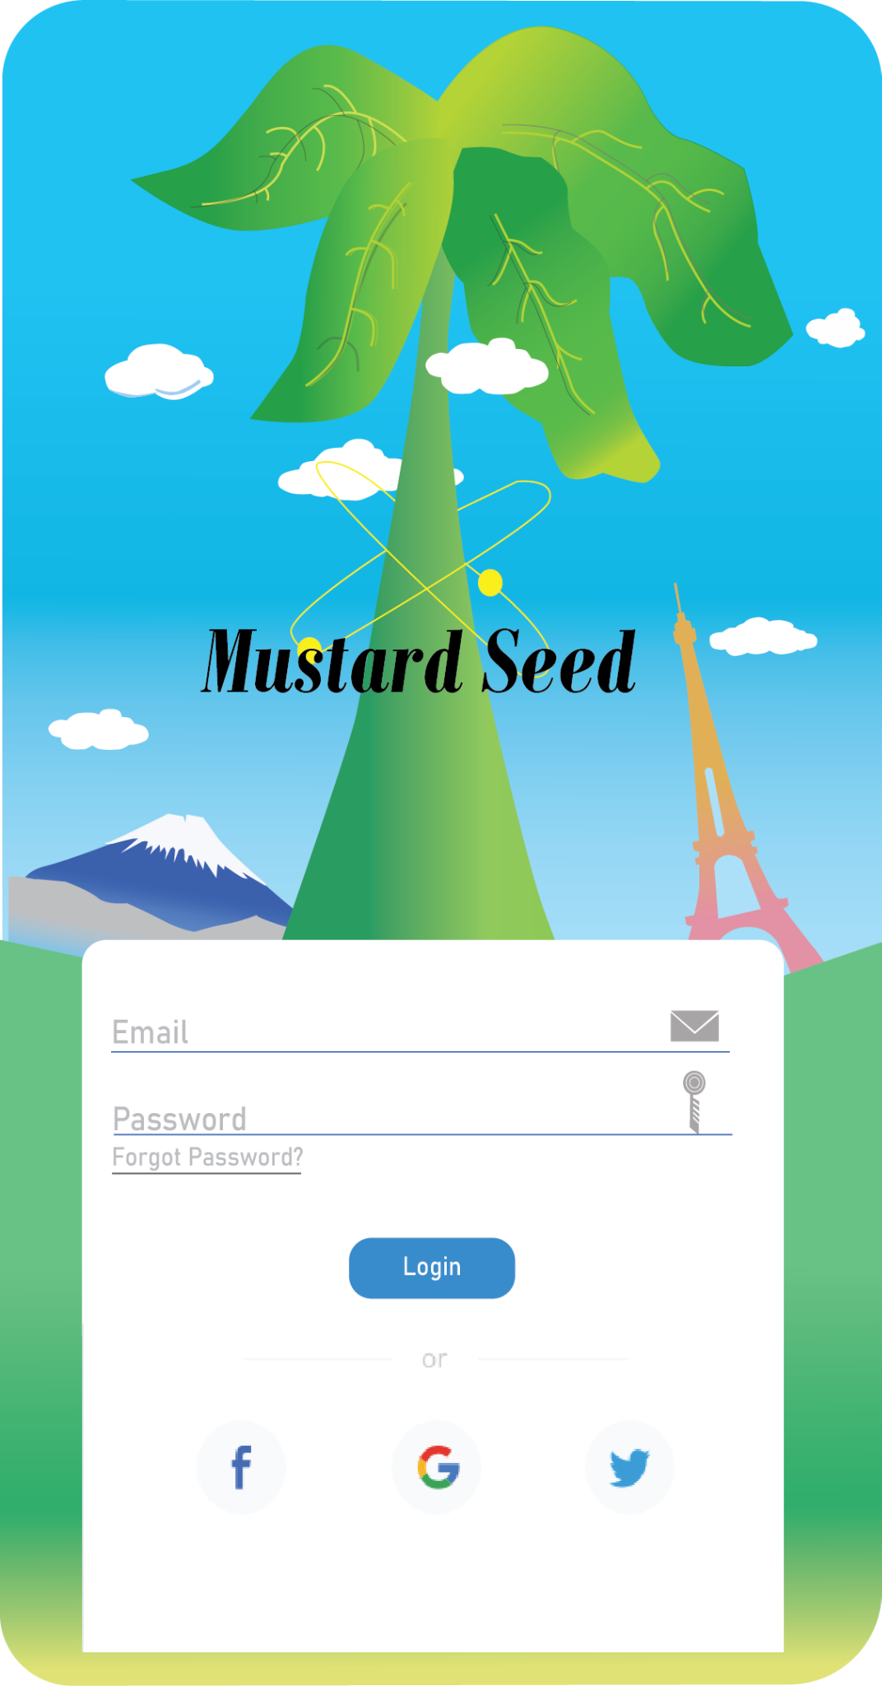
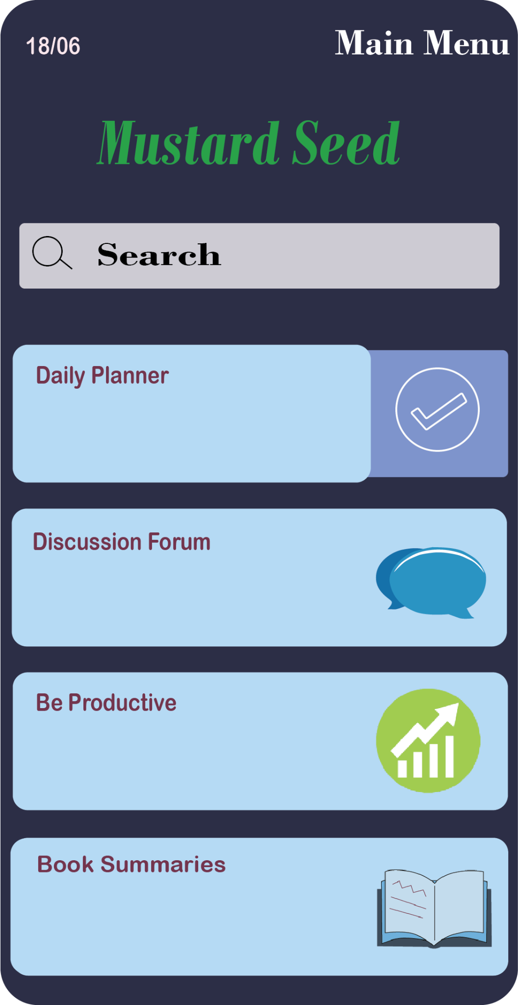
Login Page Main Menu

Slide 17
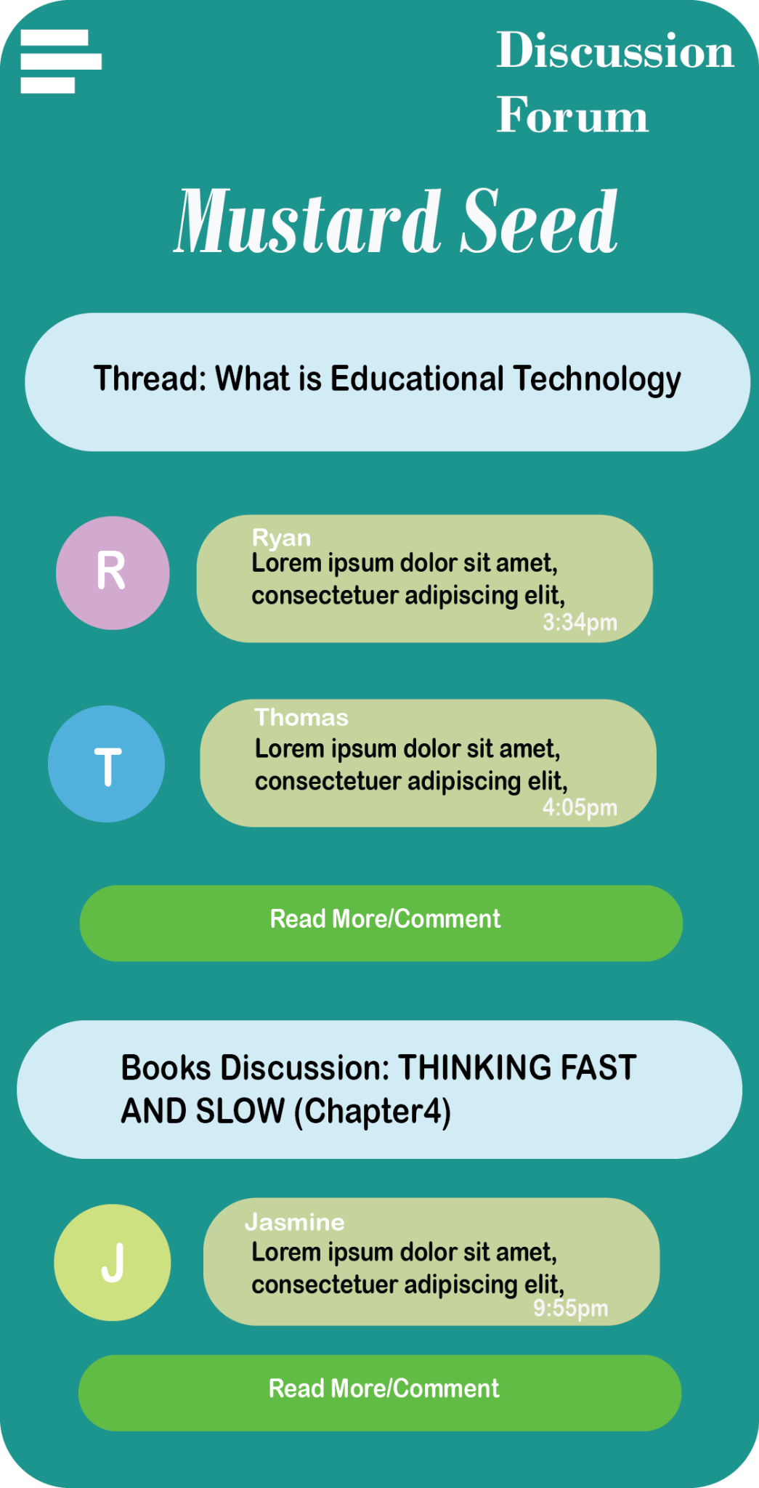
Discussion Forum
Communication platform that allows the users to share their stress and worries as well as discuss various topics.
Can also serve as a medium to meet like-minded people who are also interested in living a productive life.
Sometimes we just want a place to let out our stress and frustrations and this will serve as a channel to do so.

Slide 18
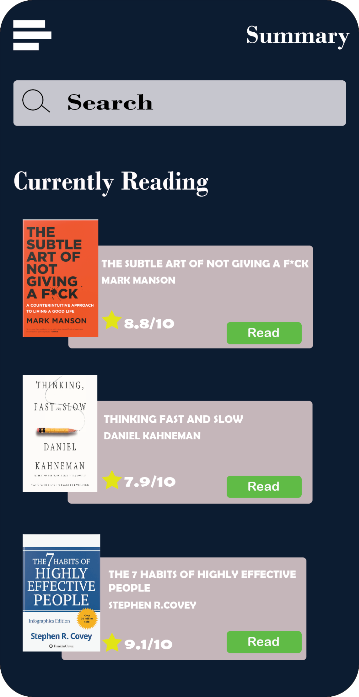
Summaries
Books related to self-improvement teach us many useful ways and paradigms on how to live a fruitful life.
Summaries allow students to reap the benefits of the book without having to spend too much time on it.
However, students have little time to read such books due to their busy schedules.
Notes:
Additionally, they can share their learnings with like-minded individuals in the forum.

Slide 19
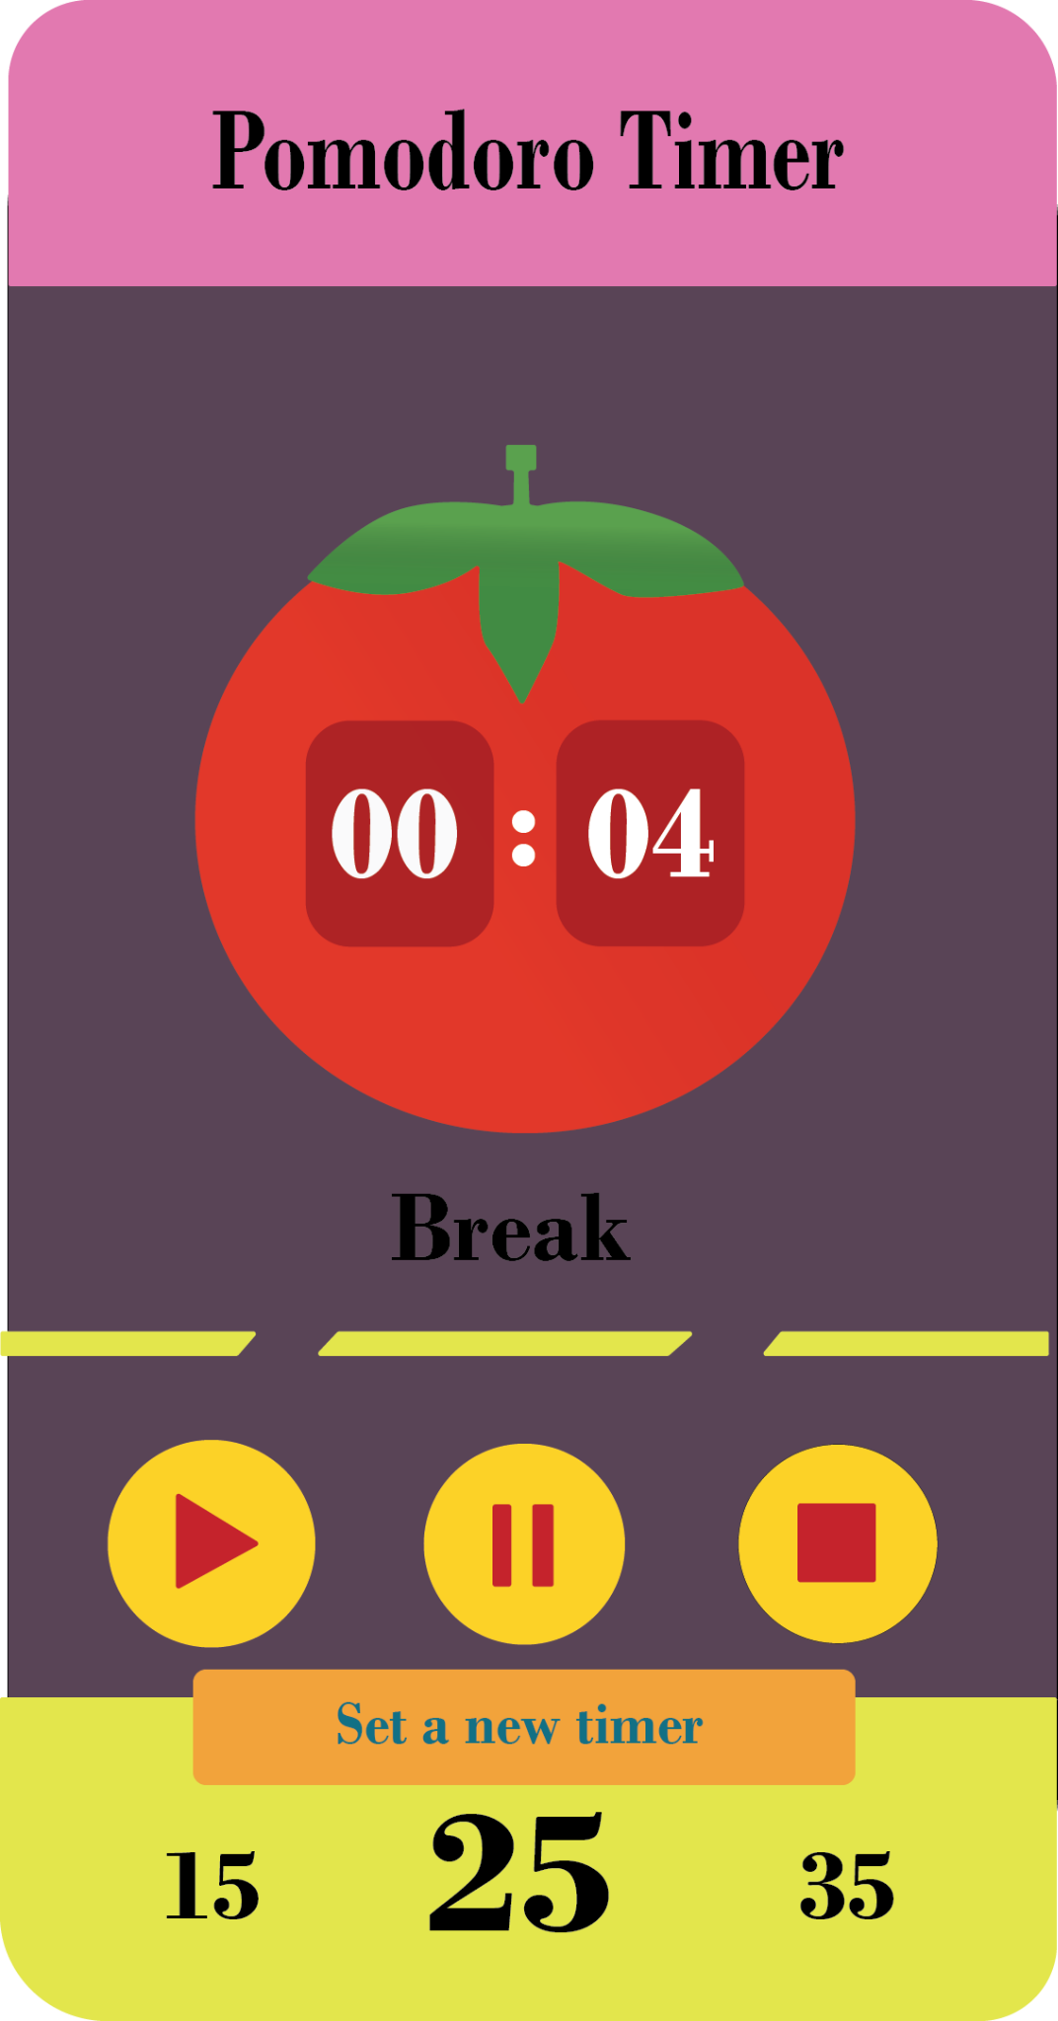
Functionalities
Daily Planner
Pomodoro Timer
Workout activities
Informative videos on user interest
Stress relief games
2. With effective time
management, students face
less stress.
3. With all of these in one place,
it is easy for the user
to makes these activities
habits and easy to remember
to do.
1. The functionalities of this
app consist of activities that
helps user relief stress

Slide 20
Overall…
We realised that students poor management of time and stress caused them to suffer
Serve as a tool to help students manage their stress and cultivate better habits
It is a multipurpose app that allows users to share their thoughts, learn and manage stress
We believe this gives it a competitive edge over other apps

Slide 21

Thank you !!

Slide 22
Q & A

